Slide 1


SRI RAMAKRISHNA ENGINEERING COLLEGE
[VATTAMALAIPALAYAM, N.G.G.O. COLONY POST, COIMBATORE – 641 022.
[Autonomous Institution, Accredited by NAAC with ‘A’ Grade]
[Approved by AICTE and Affiliated to Anna University, Chennai]
[ISO 9001-2008 Certified and all eligible programmes Accredited by NBA]
POTENTIAL FISHING AREA RECOGNITION AND GUIDANCE SYSTEM
Submitted By
Amrith Venkat. K(III – EIE)
Mukesh Kumar. C(III – EIE)
Jeevaraam. K(II – EIE)
Rakul Kannan. K (II – EIE)
Sri Ramakrishna Engineering College

Slide 2
CONTENTS
INTRODUCTION
LITERATURE REVIEW
WHAT IS POTENTIAL FISHING AREA
POTENTIAL FISHING AREA RECOGNITION
SHORE SYSTEM
MOBILE SYSTEM
CAUSE FOR THIS PROJECT
CONCLUSION

Slide 3
INTRODUCTION
In Today’s Scenario, the location of potential availability of fish remains as a system without hands.
The location is present as data in the website or server and on the Coasts as a display on LCD Screen.
This project aims to acquire this data for the use of even small-scale fishermen and guide them to reach the potential fishing spots near their location.
This system makes it possible for the fishermen to reach these potential spots with ease.
This system will be in continuous contact with the fishermen and will be with them all the time.

Slide 4
LITERATURE REVIEW
http://ijarcet.org/wp-content/uploads/IJARCET-VOL-5-ISSUE-3-656-662.pdf
Fishermen nautical border alert system, International Journal of Advanced Research in Computer Engineering & Technology (IJARCET) Volume 5 Issue 3, March 2016
http://indianexpress.com/article/opinion/web-edits/fishermen-killing-a-thorny-issue-between-india-and-sri-lanka-4558809/
Fishermen killing a thorny issue between India and Sri Lanka
http://www.incois.gov.in/MarineFisheries/PfzAdvisory
Potential Fishing Zone (PFZ) Advisory
http://ccari.res.in/Technical%20Bulletin%20No.%2040.pdf
A Manual on the use of Potential Fishing Zone (PFZ) Forecast

Slide 5
WHAT IS POTENTIAL FISHING AREA ?
The potential fishing area is a surrounding in which the availability of the fishes is abundant.
These areas are recognized by thermal imaging from by the satellites and been recorded.
The Potential Fishing Zones are divided into 14 coastal regions throughout the country.
This data is provided by the Indian Government via INCOIS (Indian National Centre for Ocean Information Service).
This data is regularly refreshed on every Monday, Wednesday and Friday.

Slide 6
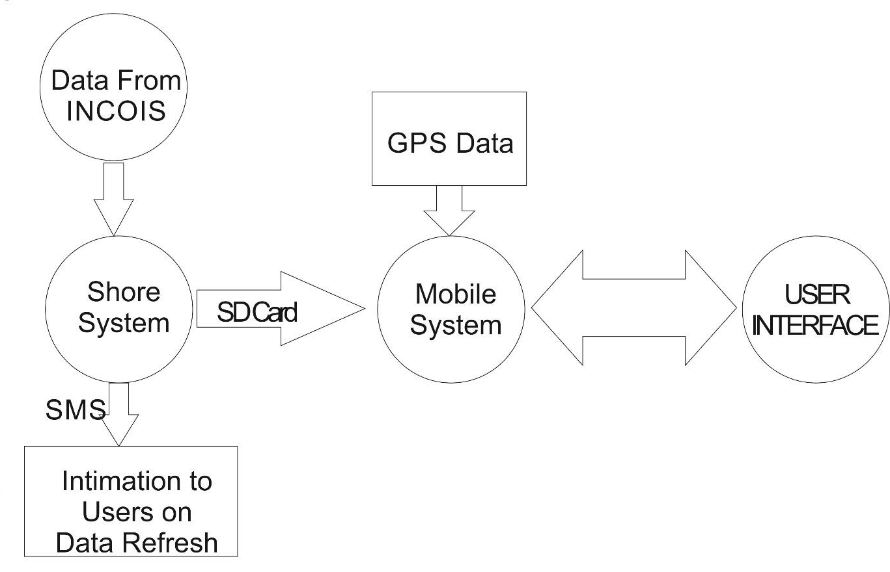
POTENTIAL FISHING AREA RECOGNITION
A COMPLETE OVERVIEW

Slide 7
SHORE SYSTEM
The data from INCOIS is acquired as latitude and longitude information and stored in a SD-Card.
This data stored SD-Card is used in the Shore System of the setup.
Moreover the data has to be changed periodically for every 48 hours.
While the user registers himself for the first time in the Shore System, his contact number is also received and stored.
Whenever the INCOIS data is refreshed and the Shore System completes updating the same, an intimation will be sent to the registered contact numbers so that the Potential Fishing Zones are not out-dated.
The International Border Co-ordinates are stored in such a way that these data cannot be tampered with.

Slide 8
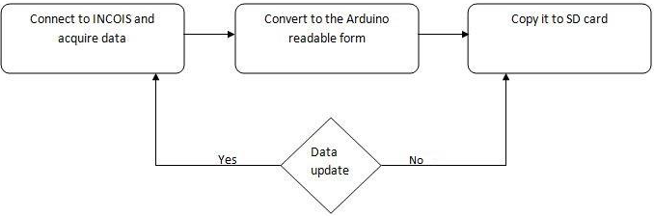
Contd..
Shore System – Flow of Process

Slide 9
MOBILE SYSTEM
The Mobile System consists of GPS Receiver, Central Controller, LCD Display and SD Card Reader.
The Central Controller consists of Arduino unit and Four Input buttons. The Mobile System first checks for the stored Location Data in the SD Card.
If data is found, the location will be displayed to the user from which the user can select his preferred destination region.
Then, the system starts to receive the present location data from the attached GPS Module.

Slide 10
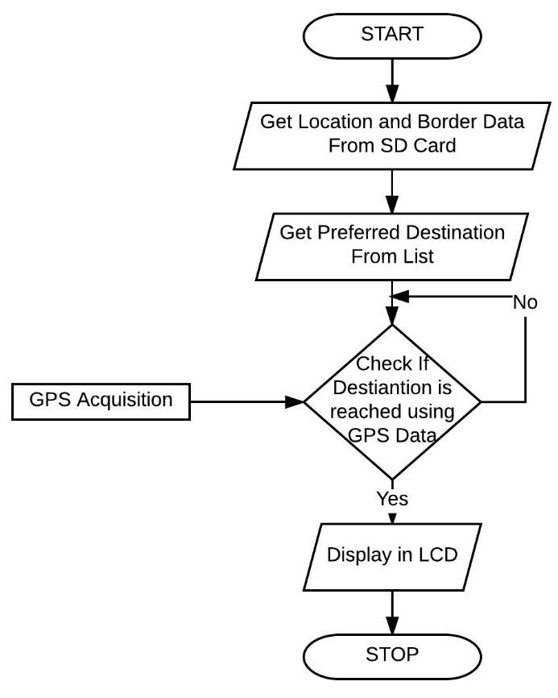
Contd..
Mobile system – Flow of Process

Slide 11
Contd..
The Controller compares the present location with the user defined location and indicates its absolute bearing and distance to location.
If the location is reached, a signal indicating the same is displayed.
Caution is taken to see that international water boundaries are not crossed by referencing the co-ordinates present on the SD card and the Internationally agreed boundaries.
The Mobile System also logs the present GPS Data to the attached SD Card every five minutes

Slide 12
CAUSE FOR THIS PROJECT
At present, there is a ongoing conflict that Sri Lankan Navy arrests fishermen due to potential threat of terrorists.
In such case the log of the system can be used as a proof that they have no wrong intentions.
This log can also be used by NGOs and other Government agencies to monitor and guide the efficient route to the destination and enable such organizations to provide knowledge about route planning efficiency.
In Extreme Cases, if the fishermen are taken hostages by Pirates or any other anti-socialists, this GPS Log could be used as a proof for detecting and identifying the base of operations of such anti-socialistic groups.

Slide 13
CONCLUSION
This Project not only aims to make the Potential Fishing Zone more realistically available to fishermen but also to make the data available to lower-class fishermen too.
The cost would be very minimal when compared to conventional one which makes this system a more-efficient one.
The Tertiary merits of this system include that the ratio between energy used and income from fishing could increase as this system guides the fishermen directly to a more reliable area than the fishermen using their long-acquired instinctual knowledge.

Slide 14



